Slide 1
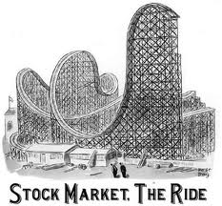
Stock Market Basics
How a company “Goes public”…
By
Vishwanath
Aravind
Sunny
Vamshi
Sasank
Prashanth

Slide 2
Some Financial Terms…
Earnings per share ,the amount of profit to which each share is entitled
IPO : Short for Initial Public Offering . An IPO is when a company sells stock in itself for the first time
Going public means slang for when a company is planning an
IPO
Share: A share represents an investor’s ownership in a share of the profits , losses and assets of a company . It is created when a business carves itself into pieces and sells them to investor in exchange for cash.

Slide 3

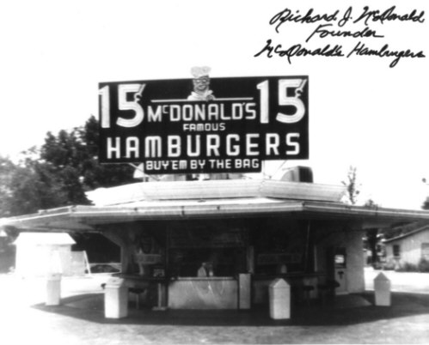
Stock Market
Dell computer began with Michael Dell selling computers out of his college dorm room
McDonald’s was once a small restaurant no one had heard of.

Slide 4
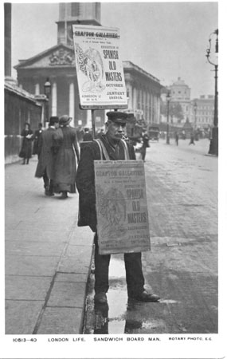
How did they grow?
How did these small companies grow from tiny, hometown enterprises to three of the largest businesses in the American economy?
They raised capital by selling stock in themselves.

Slide 5

What is a stock market?
A stock market or equity market is a public entity (a loose network of economic transactions, not a physical facility or discrete entity) for the trading of company stock(shares) and derivatives at an agreed price; these are securities listed on a stock exchange as well as those only traded privately.
Also,
Stocks are a type of security that signifies ownership in a corporation and represents a claim on part of the corporation's assets and earnings.

Slide 6
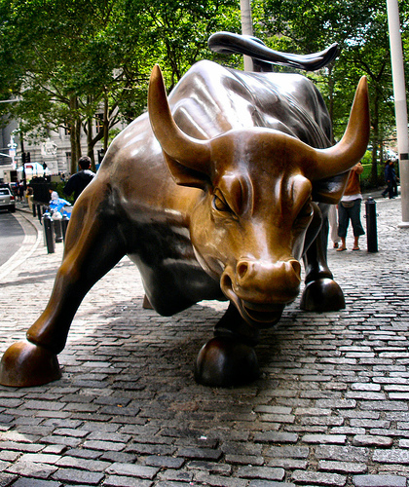
Types:
Common Stock ,usually entitles the owner to vote at shareholders' meetings and to receive dividends.
Preferred ,generally does not have voting rights, but has a higher claim on assets and earnings than the common shares.

Slide 7
Why stocks?
The stock market is one of the most important sources for companies to raise money. This allows businesses to be publicly traded, or raise additional financial capital for expansion by selling shares of ownership of the company in a public market.
By selling shares they can sell part or all of the company to many part-owners.
The liquidity that an exchange provides affords investors the ability to quickly and easily sell securities. This is an attractive feature of investing in stocks, compared to other less liquid investments such as real estate.

Slide 8

How to buy?
There are various methods of buying and financing stocks. The most common means is through a stock broker. Whether they are a full service or discount broker, they arrange the transfer of stock from a seller to a buyer. Most trades are actually done through brokers listed with a stock exchange.
And now how to sell ?
Selling stock is procedurally similar to buying stock. Generally, the investor wants to buy low and sell high, if not in that order (short selling); although a number of reasons may induce an investor to sell at a loss, e.g., to avoid further loss.

Slide 9
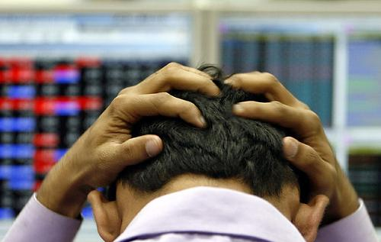
Crash…
A stock market crash is a sudden dramatic decline of stock prices across a significant cross-section of a stock market, resulting in a significant loss of paper wealth. Crashes are driven by panic as much as by underlying economic factors. They often follow speculative stock market bubbles.

Slide 10

Or else….
A stock market crash is often defined as a sharp dip in share prices of equities listed on the stock exchanges
There have been famous stock market crashes that have ended in the loss of billions of dollars and wealth destruction on a massive scale
One of the most famous crash took place on October 19, 1987 – Black Monday. The crash began in Hong Kong and quickly spread around the world.
The crash in 1987 raised some puzzles-–main news and events did not predict the catastrophe and visible reasons for the collapse were not identified

Slide 11


